Slide 1
Power to Create Jamie Cooke, Head of RSA Scotland
@JamieACooke
@theRSAScotland

Slide 2
The RSA
“Enriching Society through Ideas and Action”
FRSA
Networks and impact
Key priorities, online and offline resources

Slide 4
Creative Capacity
“Creative capacity building should not be misrecognised as the reiteration of an oft-repeated call to a more student-centred approach. Rather, it signals a fundamental shift towards a more complex and experimental pedagogical setting…” (McWilliam & Haukka, 2008, p23)

Slide 5
PtC in Education
Elusive concept, but with huge impact
Creativity is not garnish to the ‘roast’ of education or industry
Multitude of reasons
Pedagogical – underpinning educational success
Technological – a world of ideas, opportunities and barriers, some of which we don’t even know we face yet
Economic – jobs for the future
Won’t just happen though, needs conscious effort and change – not just the arty, but everyone

Slide 6
Creative Education
Creative Learners
Creative Educators
Creative Systems

Slide 7
Creative Learners
Opening Minds
Pupil Design Awards
Catalytic Teaching and Learning

Slide 8
Opening Minds
Curriculum developed by the RSA in 2000
Looks to address the needs of pupils as citizens, learners and employees
Not ‘off the shelf’ – focus on core learning competencies but within the specific context of the school and community

Slide 9
Opening Minds
Students plan their work with greater degree of freedom, ‘blurring’ of subject boundaries – appreciate different learning styles
School wide ethos, not just learning approach
Over 200 schools using across England

Slide 10
Pupil Design Awards
SDA are the world’s oldest design award competition
Chance to move this into schools
Opportunities for creative learning with school pupils, ‘different’ ways of learning
Bring in external partners – designers, MAKLab, businesses

Slide 11
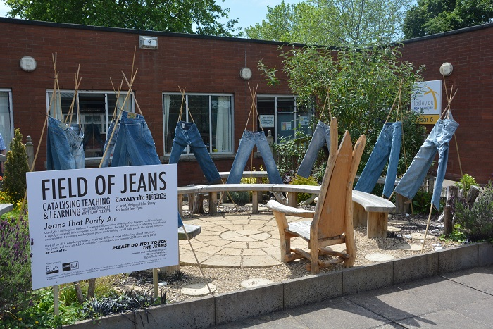
Catalytic Teaching

Slide 12
Creative Educators
Licensed to Create
Innovative Educators’ Network
Area Based Curriculum
About a place, By a place, For a place

Slide 13
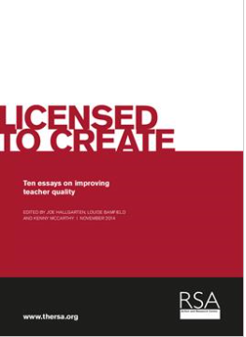
Licensed to Create
Ideas for innovation
Values the role of the teacher
Innovation within a system
Grand Curriculum Design
What about Scotland?

Slide 14
Innovative Teaching
Networking teachers for skill and knowledge sharing
Parent’s Evenings: From awkward to awesome!
Teacher to teacher ‘marketing’

Slide 15
Area Based Curriculum
Ideas for innovation
Values the role of the teacher
Innovation within a system
What about Scotland?

Slide 16
Creative Systems
Family of Academies
School Governors
Policy

Slide 17
Family of Academies
Set up in 2011, a family of schools in England
Opening Minds curriculum
Connection to RSA Fellowship through projects and mentoring
Arts Hub; Opening Minds Hub

Slide 18
Governors
Governance matters
Analysis of the system, challenges and opportunities
Work with Governors themselves
What implications for Scotland?

Slide 19
Policy
Not change for change’s sake
Interaction with government and policy makers – DCMS commitment on pupil premium
Greater need for voice of teachers, pupils and parents

Slide 20
The Market Place
TES Resource Bank
RSA safe (yet challenging) space
Teacher to teacher peer learning/sharing – Strathclyde Uni
Austerity as a challenge and opportunity

Slide 21
Creative Challenge
Value of Creativity
Evidence crucial
Wicked Problems
Voices across communities and sectors
Empowerment of communities
Don’t presume it will happen - capacity
Closing the gap – won’t happen without creativity

Slide 22
What next?
Core opportunity with NCLN- the engine room for change
Is this the best it can be? Ambitious and challenging
Partnerships
Research – finding the Scottish dimension
Chance to shape RSA Scotland priorities – “chainsaws not seedings”

Slide 23
“Creativity can get you in anywhere”

Slide 24
Questions
Jamie Cooke
Jamie.cooke@rsa.org.uk
@JamieACooke

